Slide 1
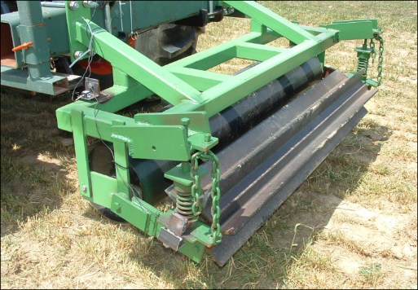
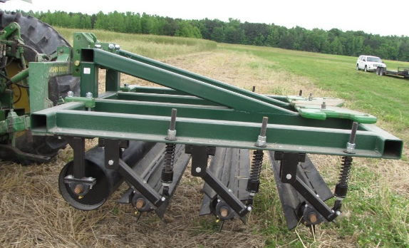
Multistage Crop Roller
The multistage crop roller device (two and four stage rollers are shown) is used to roll over and terminate cover crops. It effectively terminates cover crops without transmitting excessive vibrations to the operator and is compatible with small and larger farm operations. For smaller farming operations with a limited power source, the device may be towed across a field by a small 4-wheel or self-propelled tractors.
Benefits
The crimping force can be adjusted to target different cover crops for different soil types and moisture conditions
Two and four stage roller can maintain specific adjustable crimping force that is independent of operating speeds
Prototypes are built
Applications
A device to terminate cover crops in a no-till system on a large or small scale farming operations.
Docket No: 143.06
U.S. Patent No: 7,987,917
Contact: cathleen.cohn@ars.usda.gov

Slide 2
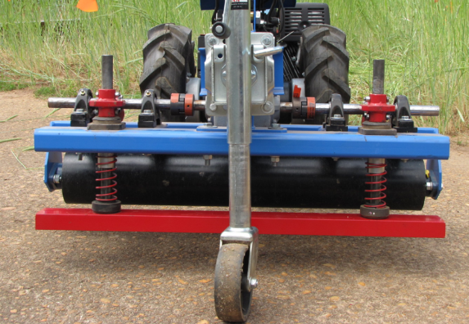
Powered Rolling and Crimping Device for Crop Termination
The powered rolling and crimping device is used to terminate cover crops in a minimum tillage soil conservation system. It is designed to attach to inexpensive, walk-behind garden tractors that are popular with small-scale vegetable farmers. In operation, as the rolling and crimping device is propelled across a field of cover crops, the crop roller rolls over the crops and the crimping bar crimps the crops, thereby terminating the cover crops and preparing the field for planting the next cycle of crops.
Benefits
Developed specifically for limited-power, walk-behind garden tractors
The crimping frequency is independent of operating speed and is controlled by engine’s RPM
Number of crimps over a distance can be adjusted by adjusting operating tractor’s speed
A prototype has been built
Applications
A device to terminate cover crops in a no-till system and/or organic small farming operations
Docket No: 23.10
U.S. Patent No: 8,176,991
Contact: cathleen.cohn@ars.usda.gov

Slide 3
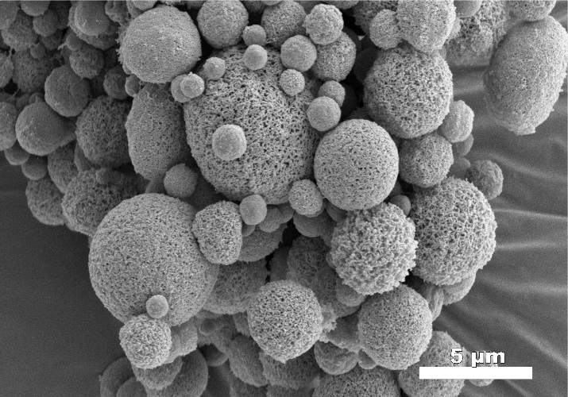
Starch Foam Microparticles
Starch-based foam microparticles with a porous structure and a diameter of less than or equal to 50 microns used to control Varroa mites in honey bee colonies. Essential plant oils effective in controlling parasitic mites are encapsulated in the microparticles that are small enough to be eaten or to attach to the hairs on bees similar to pollen grains.
.
Docket No: 34.06
U.S. Patent No: 8,163,309
Contact: cathleen.cohn@ars.usda.gov
Benefits
Encapsulation of essential oils in porous microparticles within the size of pollen grains that can be easily dispersed
The particles are able to form a free-flowing powder and mixed with other bee attractants such as powdered sugar
Applications
Beekeeping industry -feeding bees essential oils that have mitocidal properties
Pharmaceutical industry for encapsulating drugs
Producing degradable composite plastics
Fragrance industry

Slide 4
Preparation and Uses of Locked-Ring Sugar C-Glycoside Derivatives
A process for producing derivatives of C-glycosides called “locked-ring sugars” wherein the ring of the sugar molecule remains intact without the need for any protecting groups. The C-glycosides can be conjugated to biotin via a hydrazine or ozime based linker. The “locked-ring sugar” biotin hydrazones bind to streptavidin.
Docket Nos: 70.06 & 188.09
U.S. Patent Nos: 7,888,500 & 7,888,500
Contact:
cathleen.cohn@ars.usda.gov
Benefits
The “locked-ring: sugar derivatives including biotin hydrazones retain the antigenic properties of their parent sugars
The process is simple to preform using water as the reaction solvent, at mild temperatures, with readily available starting materials and is nearly quantitative.
Applications
ELISA assay kit market
Capture and purification of antibodies that can recognize cell-surface carbohydrate motifs
Lectin recognition based products
Other techniques based on biotin-streptavidin binding

Slide 5
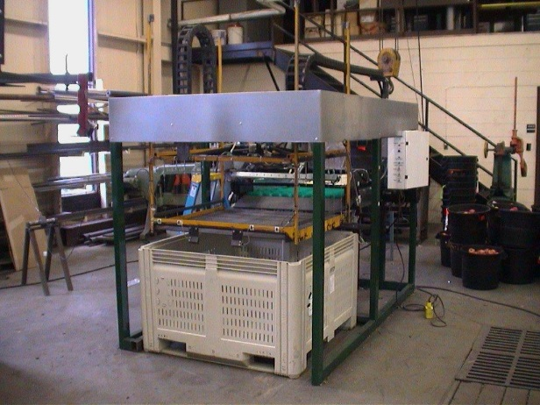
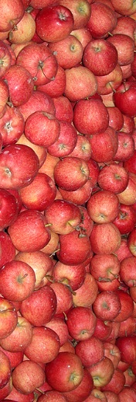
Automated Bin Filing System
An automated mechanical bin filling system for moving bulk fruit or vegetables from a feed conveyor to a mobile storage bin. The system transfers bulk products with minimal damage. It consists of three components, a fruit accumulating section, a fruit transfer incline and a mobile tray.
Peterson, D.L., Tabb, A., Baugher, T., Lewis, K.M., Glenn, D.M. 2010. Dry bin filler for apples. Applied Engineering in Agriculture. 26(4):541-549.
Docket No: 18.06
U.S. Patent No. 8,033,084
Contact: cathleen.cohn@ars.usda.gov
Benefits
Efficiently transfers bulk products from a conveyor-type feeder to a storage container without significantly damaging the products.
The invention is compact, should be commercially reliable and fills bins evenly and
Applications
A bin filler for the fruit and vegetable industry that does not inflict damage to produce during filling

